Slide 1
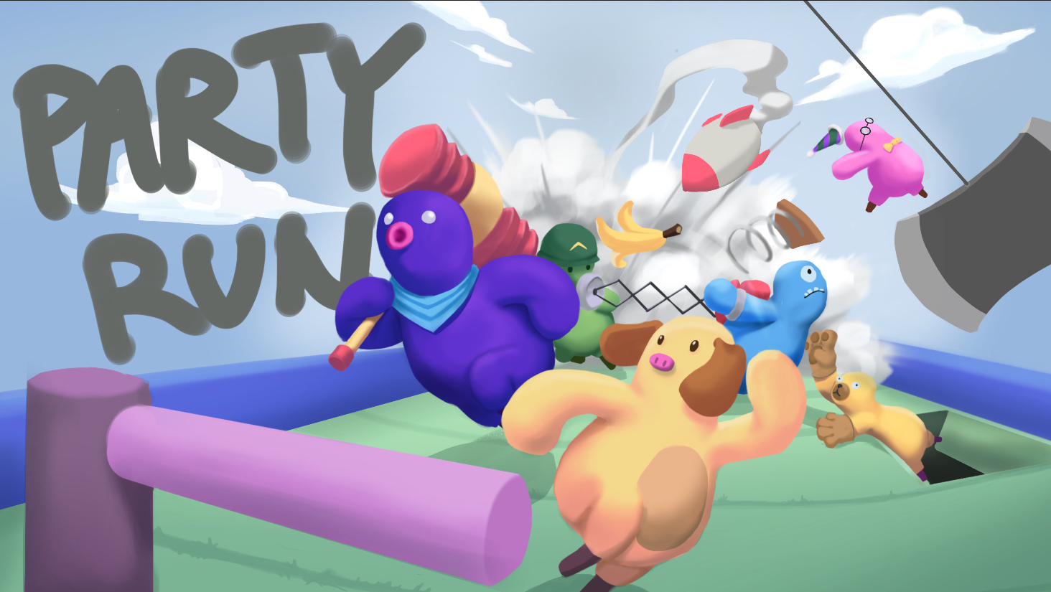
GAME PITCH V1

Slide 2
Demo打磨好之后做一个几秒钟的gif放在这里替换掉下面的图片，需要在这几秒钟之内把游戏的核心乐趣展现出来
PARTY RUN
Funny parkour-racing game where players control their characters by running.
In Party Run you will complete against other players in randomly-generated parkour courses. Use a wide array of absurd items to destroy friendships, take the top spot in exciting mini-games, win the golden trophy and become the party winner! All while getting a good sweat.
*It’s Fall guys + Mario party but you play it by running, like in Ring Fit Adventure

Slide 3
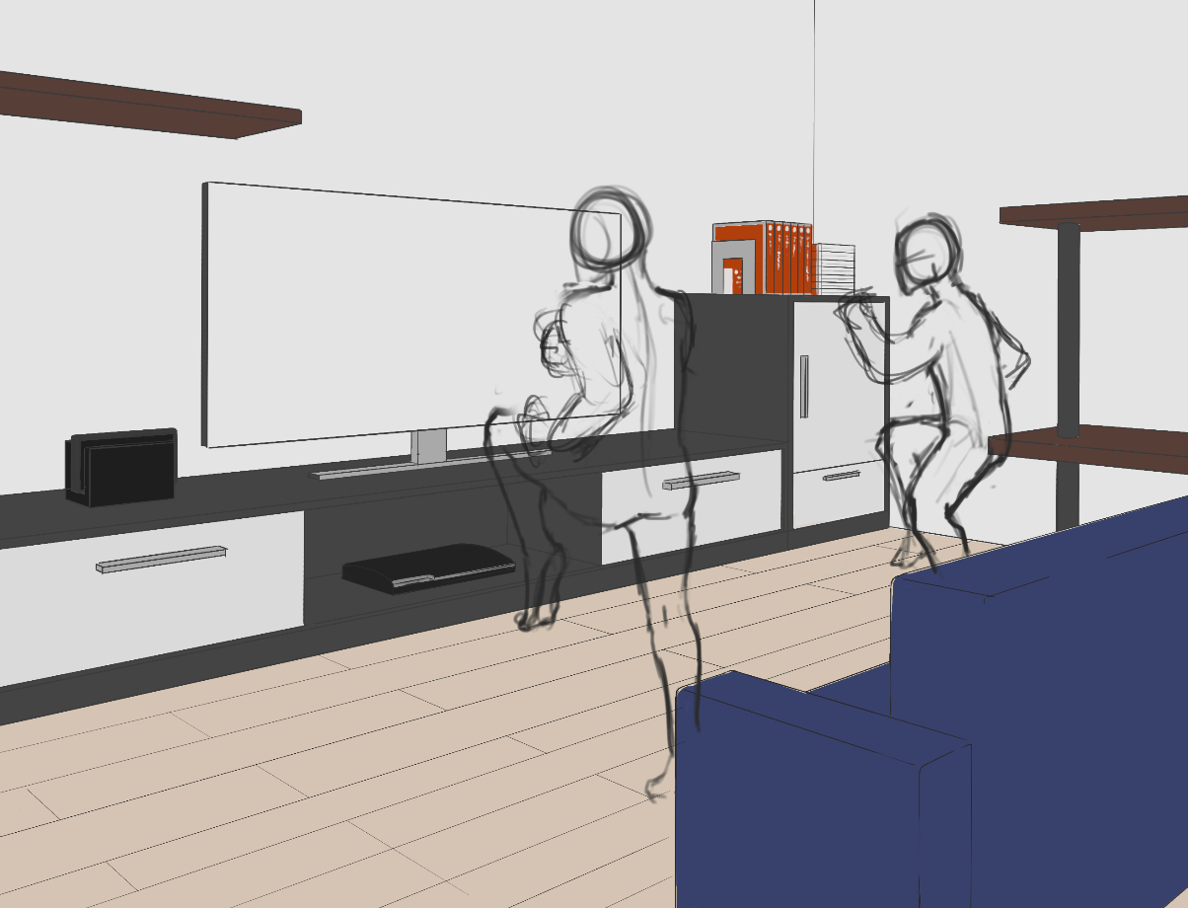
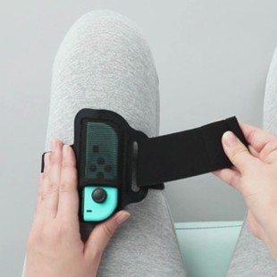
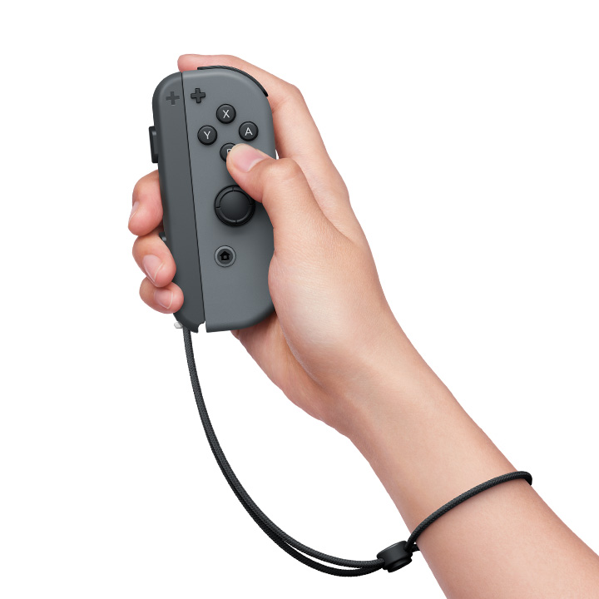
CONTROL
On leg
One joy-con will be attached to a leg. By running, players can control the character to run forward and jump.
On hand
The other joy-con will be handheld, tilting the joy-con will control the direction. Punching motion can trigger special move.

Slide 4
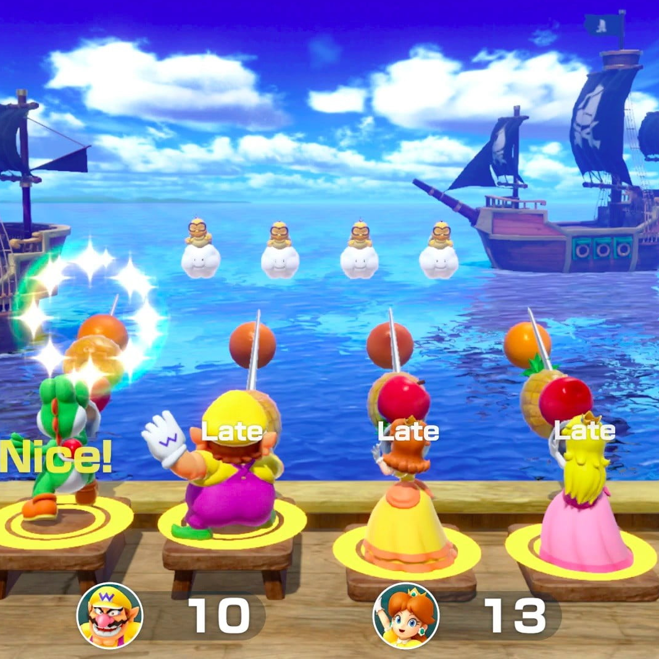
CORE GAMEPLAY
PARKOUR COURSE 1
PARKOUR COURSE 2
PARKOUR COURSE 3
PARKOUR COURSE 4
START
MINI GAME 1
MINI GAME 2
MINI GAME 3
FINISH
Race:
Players will race on a series of short parkour courses. At each finish line they will get trophies depending on the places.
Mini games:
A random mini game starts at the end of each finish line. When the game ends, players will get trophies depending on the places and the next race starts. This loop will go on several times until finish. At last, player who has the most trophies wins.

Slide 5
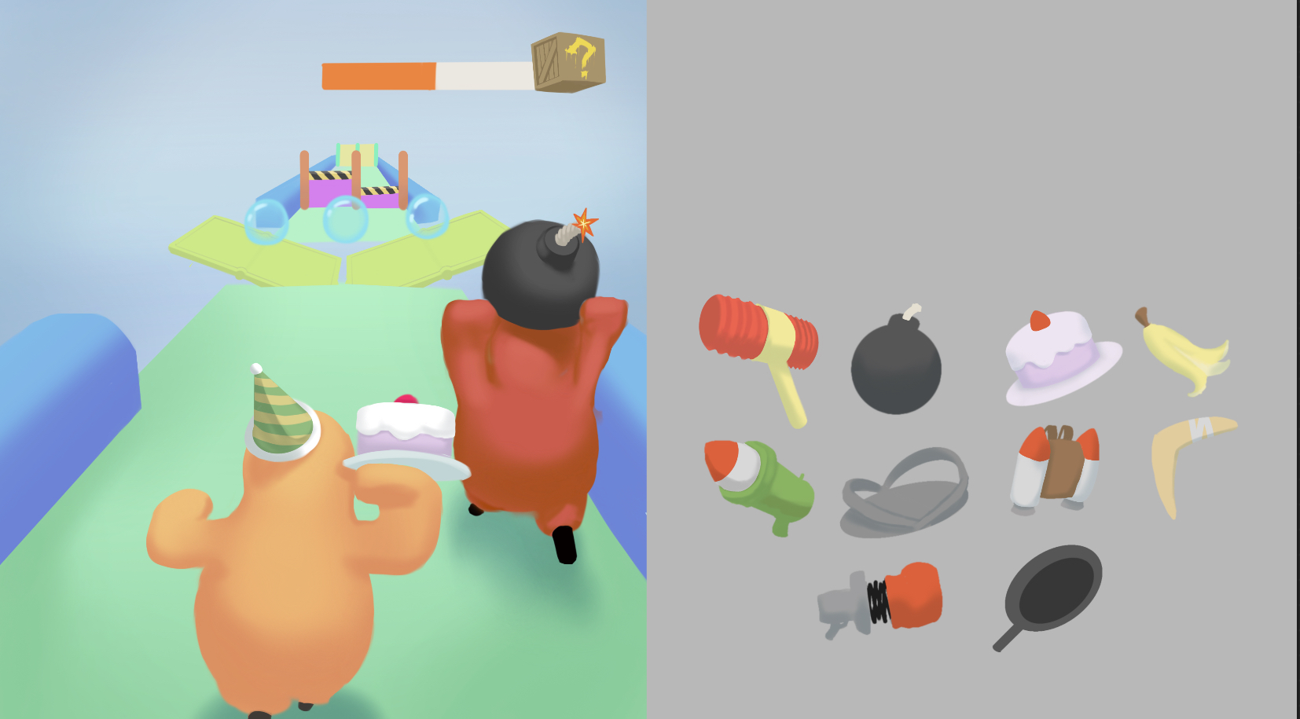
CORE FEATURE: PARKOUR
RANDOMLY GENERATED MAP
Crazy, Chaotic and fun
Funny, interactive items

Slide 6
GAME MODES
PARTY MODE
ELIMINATION MODE
FREE MODE
Solo/Online multiplayer/ Split screen
Solo/Online multiplayer/ Split screen
Solo
Race against other players, compete or collaborate in mini games and collect as many trophies as you can!
Run against other players, avoid been chased by the monster, become the last one standing!
Set your own training plan, run on free parkour courses!

Slide 7
THE HOOK
Control your character by running which gives you real health benefit.
Multiplayer obstacle racing that is crazy, chaotic and funny.
Use a wide range of absurd items to destroy friendships.
Fun, exciting mini games of all kinds
Unlock or buy cool cosmetics using the calories you burned in game.

Slide 8
COMPETITION
Exercise level
Fitness boxing
Ring fit adventure
Party run
Just Dance
Gamification
NS Sports
Mario party
1,2 SWITCH
竞品分析

Slide 9
DIFFERENTIATOR
Fitness boxing is a personal boxing training app
Just Dance is a dancing simulator
Ring fit adventure is an exercise game aiming to make personal training less boring
Mario party is a fun party game that uses motion sensing, but it don’t give enough exercise.
Party Run is a fun party game, but you get good exercise as a byproduct

